Slide 1


Automating Absorption Line Identification in Quasi-Stellar Object Sightlines Using Probabilistic Programming
Space Grant Symposium - University of Arizona Tucson, AZ
April 23rd, 2022
Bryanna Gutierrez-Coatney¹ , Sanchayeeta Borthakur¹
[1] Arizona State University School of Earth and Space Exploration

Slide 2
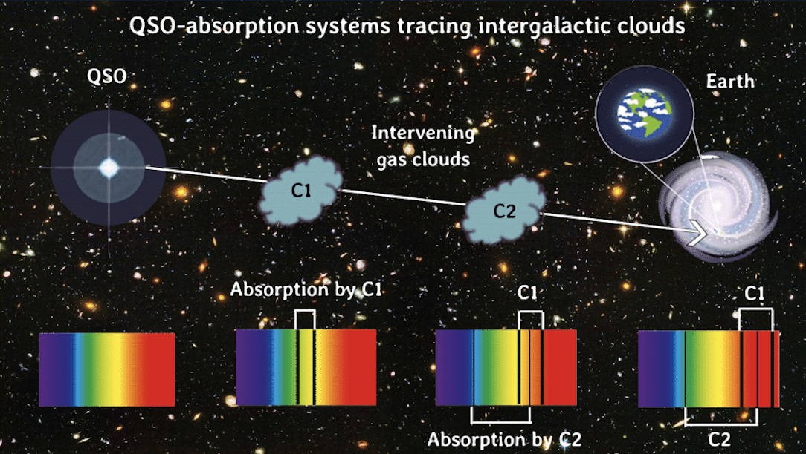
Probing the Intergalactic Medium
The intergalactic medium
Challenges
Why automate?
Figure 1: QSO shining through multiple gas clouds before light arrives at Earth adapted from Nayyar et al. 2019, AAS, 23420305N

Slide 3
Objectives
Automate the process of spectral absorption identification
Automate the code creation to run Bayesian logic (BLOG) machine learning program
Train machine learning program to identify intergalactic cloud numbers and redshift values in QSO spectra

Slide 4
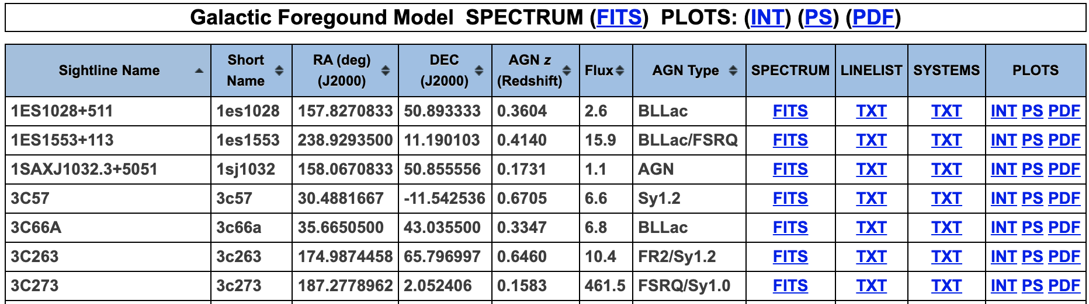
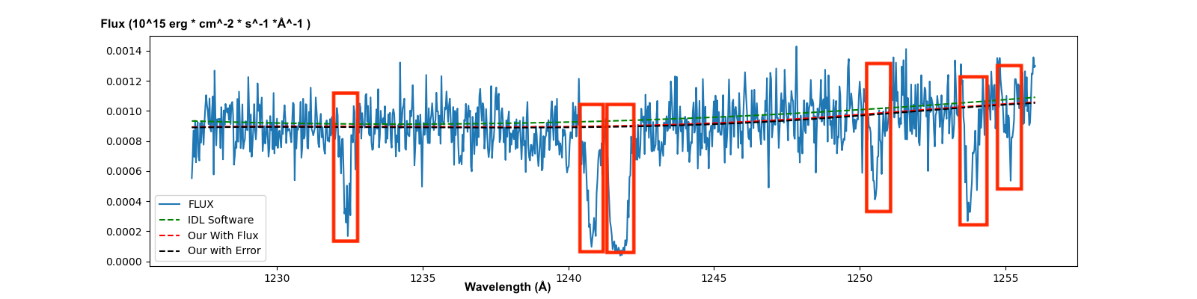
Methods & Results - spectral absorption identification
Data: Cosmic Origins Spectrograph - Hubble Space Telescope
Figure 2: Survey of the Low-Redshift Intergalactic Medium with HST/COS Danforth et al. (2016), ApJ, 817, 111
Absorptions identified as:
At least 15% below the mean
Greater than 3 sigma significance
Sliding window technique
Figure 3: Output from absorption identification python program

Slide 5
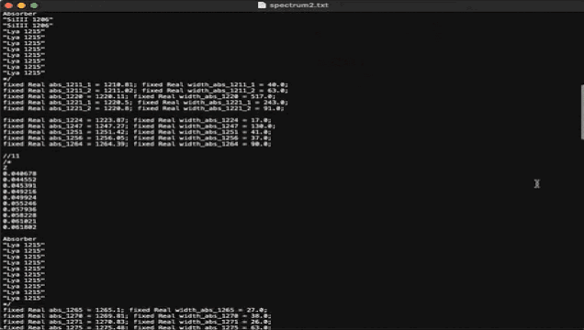
Methods & Results - code that writes code
Input: Hubble Space Telescope fits files
Cleans data
Writes blog files in Bayesian logic programming language

Slide 6
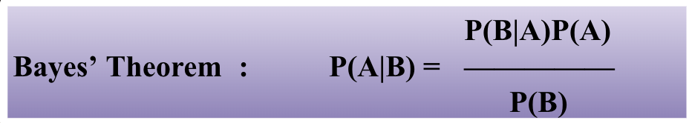
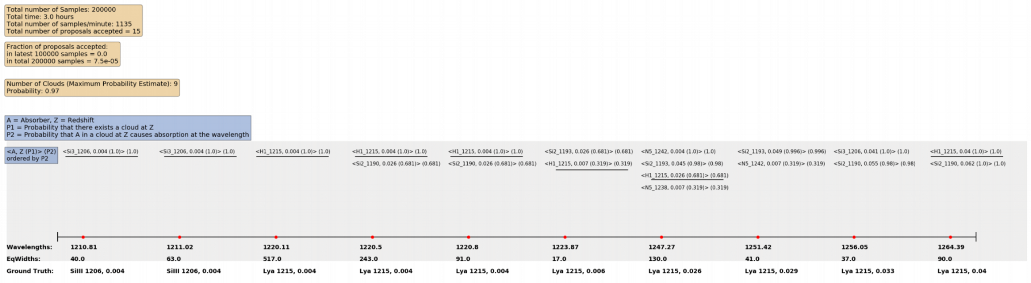
Methods & Results - train machine learning program
Use catalog of elements to train program
Bayesian logic to predict unknowns using probability
Figure 4: Bayes theorem equation
Figure 5: Output of probabilities from machine learning program

Slide 7
Future Work
Use our method to run the entire catalog of 82 sightlines and accurately predict elements within intergalactic clouds.
Extend the catalog of elements that our program can detect.
H1_972 | N5_1238
H1_1025 | N5_1242
H1_1215 | O6_1032
C2_1036 | O6_1038
C2_1334 | Si2_1190
C4_1548 | Si2_1193
C4_1551 | Si3_1206
Figure 6: Catalog of elements program can currently detect

Slide 8
Acknowledgements
Project funded by:
Arizona State University / NASA Space Grant
Advisement:
Sanchayeeta Borthakur¹
Rashmeet Kaur Nayyar²
[1] Arizona State University School of Earth and Space Exploration
[2] Arizona State University Fulton School of Computing and Augmented Intelligence
Resources:
Danforth et al. (2016), ApJ, 817, 111

Slide 9

Thank You
Email: Bgutie14@asu.edu

